Slide 1

Mid-Ladder Menaces

Slide 2

Why Do We Clash?
Simply, we clash to prove our dominance over others. In Clash Royale, players build decks of cards to battle against each other in high-pressure, intense real-time strategy matches. Like Chess, but higher skill and better.

Slide 3

Data Collection
Leaderboards of Top Players
All Data Collected through Clash Royale’s Official API
View player stats by ID
See recent battles from a player

Slide 4
Data Collection
Leaderboards of Top Players
I LOVE mid-ladder!
View player stats by ID
See recent battles from a player

Slide 5
A “Random” Sample
Battles with….
#5
Seed ID
#2
#6
#3
#4
#7
DFS!
#10
#8
#9

Slide 6
Limitations
Acts as sample of battles, not players
Will overrepresent the types of players I tend to play against
Does not have any measures against bots

Slide 7
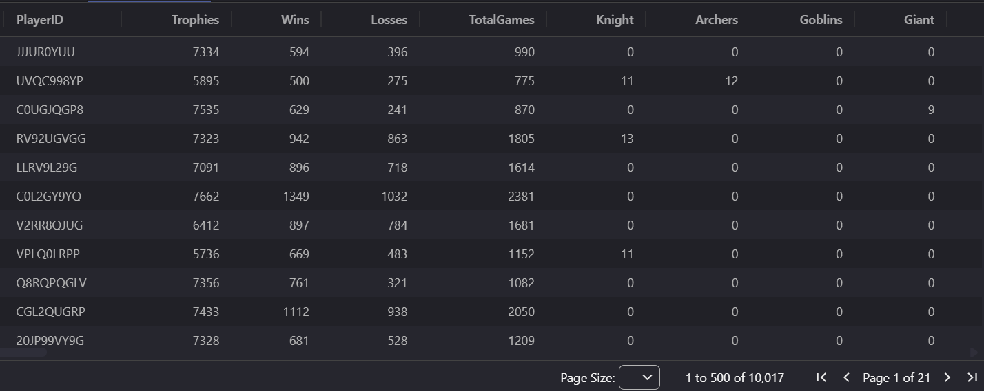
10,000 Samples

Slide 8
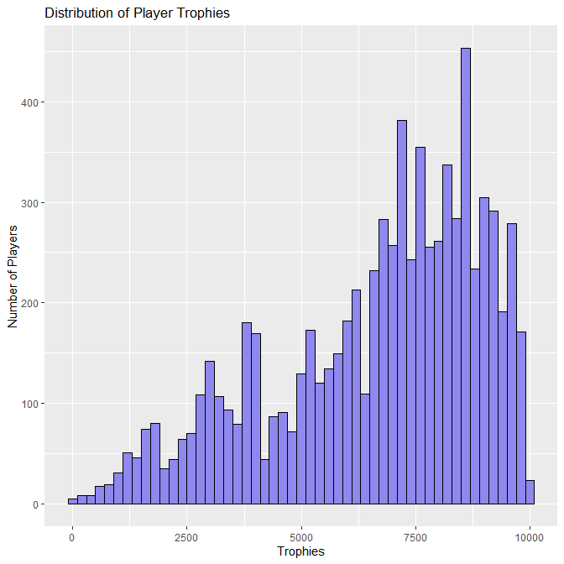
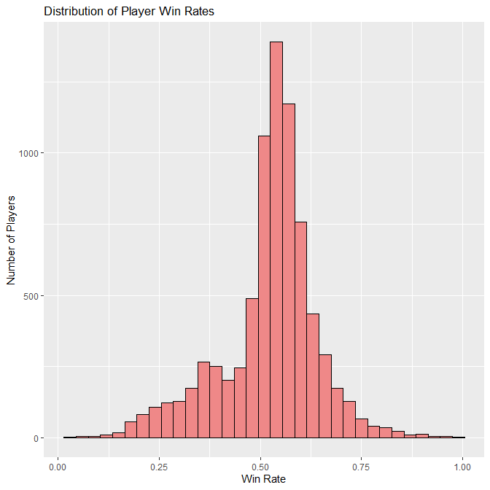
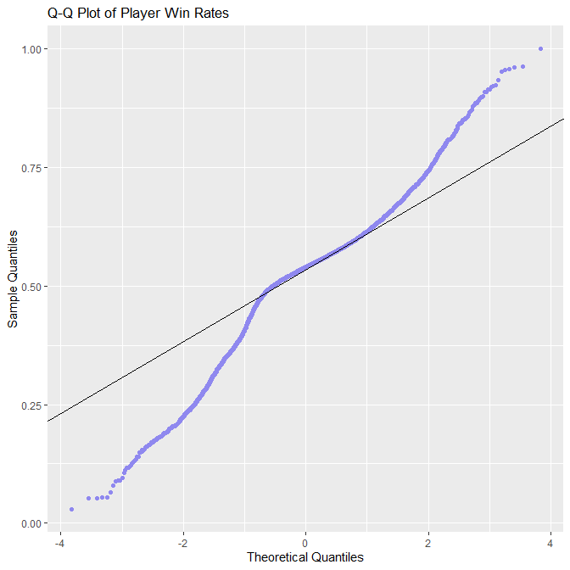
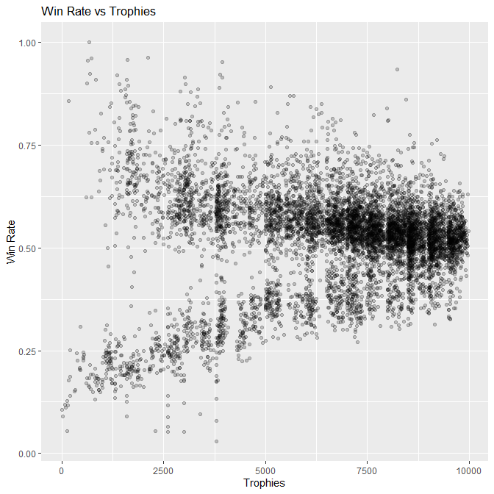
Initial Analyzing
Let’s check our assumptions.

Slide 9
Initial Analyzing
Distribution of Player Trophies:
Spikes at Arena Boundaries
Similar to Official Dist
Let’s check our assumptions.

Slide 10
Initial Analyzing
Win Rate Dist:
Mean of 54%
Stretches from 0-100%
Odd Spike at 30%
Let’s check our assumptions.

Slide 11
Initial Analyzing
Q-Q for win rate:
Not Normal
Fat tails
Lots of very low/high winrates

Slide 12
Initial Analyzing
Win Rate vs. Trophies:
Two Trendlines
Likely Bots

Slide 13

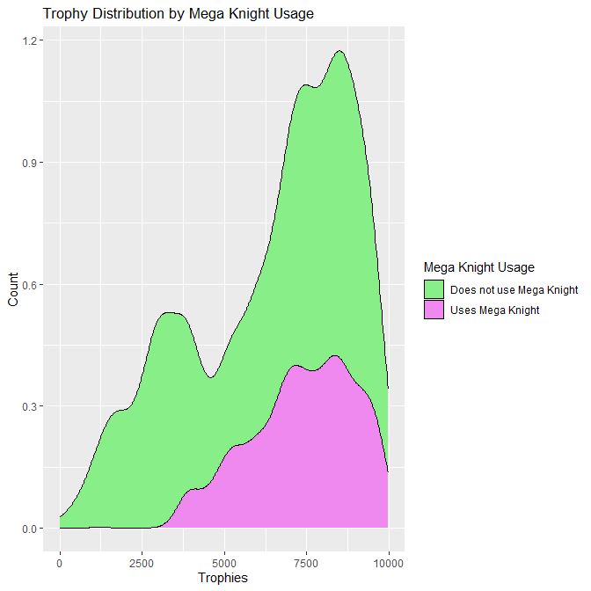
Case Study: Mega Knight
Usage Rates

Slide 14
Case Study: Mega Knight
Usage Rates
Starts around 2500 trophies
Then rises to about 25% usage rates at 7500 trophies

Slide 15
Win Rates
Statistic | Value
Test Performed | Welch Two Sample t-test
Data (Group x) | Player Win Rate (with Mega Knight)
Data (Group y) | Player Win Rate (without Mega Knight)
Trophy Range | 6000 to 8000
t-statistic (t) | 10.646
Degrees of Freedom (df) | 1504.3
p-value (p) | <2.2×10−16
Alternative Hypothesis | True difference in means is not equal to 0
95% Confidence Interval | [0.03099, 0.04499]
Mean of Group x (xˉ) | 0.56268
Mean of Group y (yˉ) | 0.52469
Mega Knight players have a significantly larger win rate compared to non-Mega-Knight users in Mid Ladder

Slide 16
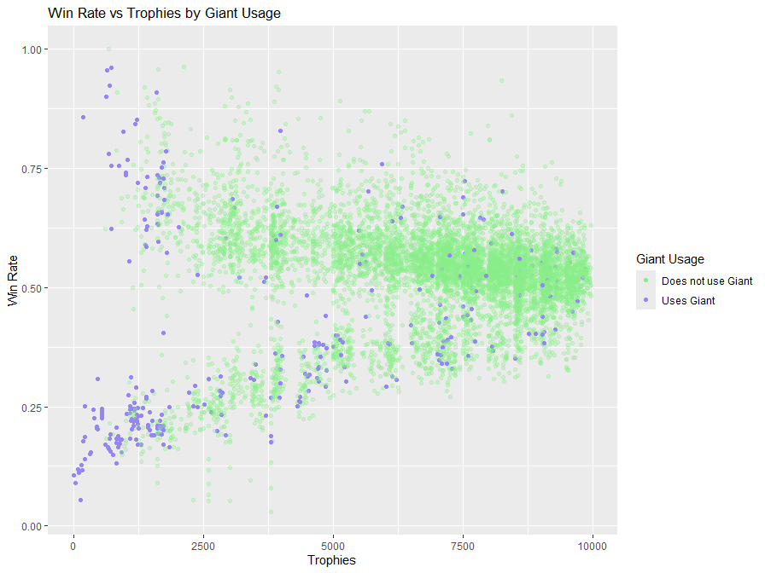
Case Study: Giant
LOWEST win rate card
Win Trading Bots!!!

Slide 17
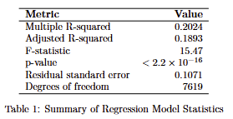
Regression Analysis
One Categorical Variable per card
Around 200 variables
No interaction terms, couldn’t get them to work
Too many decks in mid ladder

Slide 18
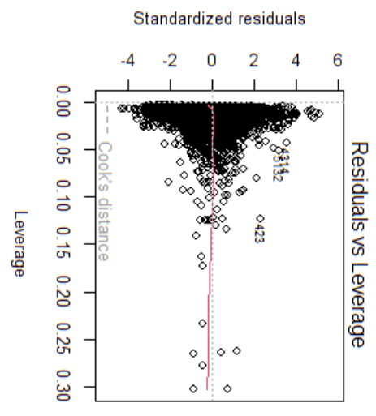
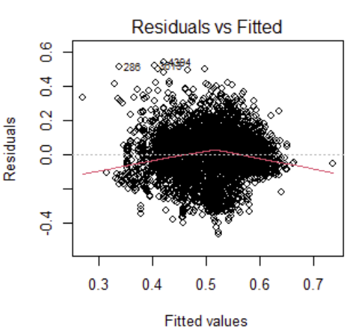
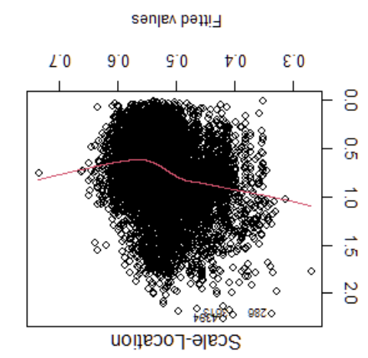
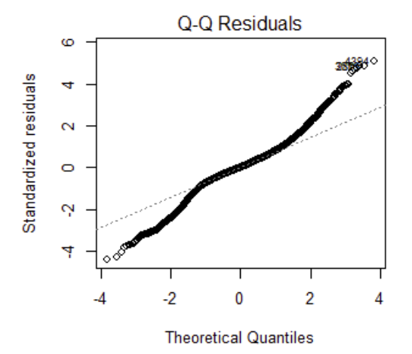
Diagnostic Plots
Gotta ensure our model works right!

Slide 19
Diagnostic Plots
No outliers
No trend in residuals

Slide 20
Diagnostic Plots
Like win rate, fat tailed
Not normal
Due to non-normality of underlying data

Slide 21
Diagnostic Plots
No trend
Indicates homoscedasticity
That means equal variances!

Slide 22
Diagnostic Plots
Cook’s D line not even visible
All low leverage
No influential points

Slide 23
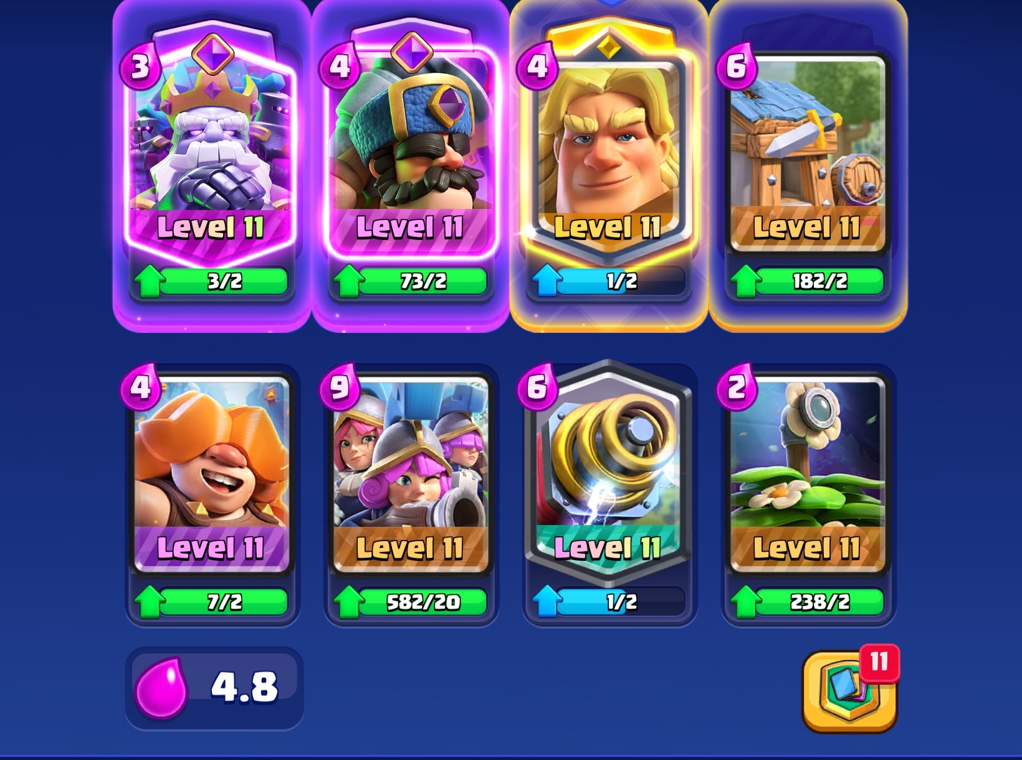
Best Deck?
Straight TRASH

Slide 24
Why does it suck?
Lack of deck synergy
No spells
Low-use cards have unusual coefficients
Correlation not causation

